Slide 1
RESEARCH METHODOLOGY & STATISTICS
Almas Jabeen Abdul Razak

Slide 2
APPROACHES TO RESEARCH
QUANTITATIVE
APPROACH
QUALITATIVE
APPROACH

Slide 3
QUANTITATIVE APPROACH
QUALITATIVE APPROACH
Rooted in the philosophy of rationalism
Follows a rigid, structured, predetermined approach
aims to quantify the extent of variation in a phenomenon ;
emphasis the measurement of variables and the objectivity of process;
believes in substantiation on the basis of large sample size;
gives importance to validity and reliability of findings and communicate findings in aggregate and analytical manner;
drawing conclusion and inferences that can be generalized
Embedded in the philosophy of empiricism
Follows an open, unstructured, flexible approach
aims at explore diversity rather than to quantify;
emphasizes the description and narration of feelings, perception and experiences rather than their measurement;
and communicates findings in a descriptive and narrative manner rather than analytical;
placing no or less emphasis on generalization.

Slide 4
RESEARCH PROCESS

Slide 5
Problem identification
A. Problem identification
B. Consideration in selecting a research Problem
C. Steps in formulating a research problem
A. Need for Literature
Literature review
B. Sources
C. Steps
A. General and Specific Objectives
Formulation of objectives
B. Hypothesis
C. Variables
A. Research Design and Plan
B. Types of study
Research Design
C. Data collection tools and techniques.
D. Sampling
E. Pilot study
F. Data collection

Slide 6
A. Editing
Data processing
B. Categorizing
C. Coding
D. Summarizing
A. Statistics
Data analysis
B. Uni-variate Analysis
C. Parametric Measures
D. Non parametric Measures
E. Econometrics
A. Report writing
Report writing
B. Stages
C. Content

Slide 7
REVIEW OF LITERATURE

Slide 8
NEED FOR REVIEW OF LITERATURE
Preventing duplicating work that has been done before
Know what others have learned and reported about the problem.
Become more familiar with the various types of methodologies.
Get good background knowledge about the problem and why research is needed in this area.
Helps to know the theoretical perspective of the problem.

Slide 9
SOURCES
Subject catalogues of libraries.
Documentation services.
Bibliographies.
List of Books and publishers bulletins.
Journals
Government reports.
Research abstract.
Information on research done.

Slide 10
TYPES OF HYPOTHESIS
Descriptive hypothesis : It intends to describe some characteristics of an object , a situation ,an individual or even an organization.
Relational Hypothesis : It intends to describe the relation ship between variables.
Empirical / Working Hypothesis : This is a hypothesis framed in early stages of research. This maybe altered or modified as research proceeds.
Null Hypothesis: This states that there is no significant difference between the parameter and statistic that is being compared.
Alternative hypothesis :they are the research hypothesis which involves the claim to be tested
Analytical hypothesis : These are used when one would specify the relationship between changes in one property leading to change in other.
Common sense Hypothesis : These are based on what is being observed with common idea existing among people.
Statistical hypothesis :These are developed from samples that measureable. They are of two types:
1. Hypothesis which indicates difference
2. Hypothesis which indicates relationship

Slide 11
VARIABLES
A variable is a characteristics of a person , object or phenomenon that can take on different values.
Variables are condition or characteristics that experimenter manipulates, control or observes.
A variable is anything that change.
Types of Variables
Numerical variables : when variables are expressed in numbers they are called numerical variables.
Categorical Variables : When the values of a variable are expressed in categories, they are called Categorical variables.
Dependent Variable & Independent Variable : the variable that is used to measure the problem under study is called the dependent variable.
The variables that re used to describe or measure the factor that are assumed to cause or at least to influence the problem are called independent variable.
Active Variable: The variable that are directly manipulated by the experiment are called active variables.

Slide 12
Attribute Variable: they are those characteristics which cannot be altered by the experiment.
Intervening Variables : certain factors or variables may influence the relationship even though they cannot be observed directly and they are called intervening variables
Extraneous variables : They are those uncontrolled variables that may have significant influence upon the results of a study.

Slide 13
RESEARCH DESIGN
A research design a logical and systematic plan prepared for directing a research study .
It constitutes the blueprint for the collection , measurement and analysis of data.
It is the plan , structure , strategy of investigation conceived so as to obtain answers to research question.
Essential of a good research design
Plan
Outline
Blue print
Scheme

Slide 14
CLASSIFICATION OF DESIGNS
Experimental
Exploratory
Descriptive
Historical
Case studies
Survey
Combination of any of these.

Slide 15
RESEARCH PLAN
A research plan prescribes the boundaries of research activity and enables the researcher to channel his energies in the right work.
Various question are needed to be answered while preparing the plan
What the study is about?
Why the study is made?
What is it scope ?
What are the objectives of the study?
What kind of data are needed?
What are the sources ?
What is the sample size?
What are the techniques?
How the data should be processed?
What is the cost involved ? etc.

Slide 16
CONTENTS OF A RESEARCH PLAN
Introduction
Statement of the problem
Review of the previous studies
Scope f the studies
Objective of the study
Conceptual model
Hypothesis
Operational definition of concepts
Geographical area to be covered
Reference period
Methodology
Sampling plan
Tools for gathering data
Plan of analysis
Chapter scheme
Time budget
Financial budget

Slide 17
SAMPLING
Sampling is the statistical process of selecting a subset (called a “sample”) of a population of interest for purposes of making observations and statistical inferences about that population. Sampling, therefore, is the process of selecting a few (a sample) from a bigger group (the sampling population) to become the basis for estimating or predicting the prevalence of an unknown piece of information, situation or outcome regarding the bigger group.
Characteristics of a good sample
Representativeness
Accuracy
Precision
Size

Slide 18
SAMPLING PROCESS
Define the population or universe
State the sampling frame
Specify the sampling unit
Selection of sampling method
Determine the sample size
Specify the sampling plan
Select the sample

Slide 19
TECHNIQUES OF SAMPLING
SAMPLING
Probability sampling
Non Probability sampling
Simple random sampling
Convenience sampling
Stratified random sampling
Systematic random sampling
Judgment sampling
Cluster sampling
Quota sampling
Multi stage sampling
Snowball sampling
Matched pair sampling

Slide 20
Probability sampling: It is a technique in which every unit in the population has a chance (non-zero probability) of being selected in the sample, and this chance can be accurately determined.
All probability sampling have two attributes in common:
Every unit in the population has a known non-zero probability of being sampled, and
The sampling procedure involves random selection at some point. The different types of probability sampling techniques include:
Simple random sampling. In this technique, all possible subsets of a population are given an equal probability of being selected. Simple random sampling involves randomly selecting respondents from a sampling frame, but with large sampling frames, usually a table of random numbers or a computerized random number generator is used.
Stratified sampling. In stratified sampling, the sampling frame is divided into homogeneous and non-overlapping subgroups (called “strata”), and a simple random sample is drawn within each subgroup.

Slide 21
Systematic sampling (also known as interval sampling) relies on arranging the study population according to some ordering scheme and then selecting elements at regular intervals through that ordered list.
Cluster sampling. If you have a population dispersed over a wide geographic region, it may not be feasible to conduct a simple random sampling of the entire population. In such case, it may be reasonable to divide the population into “clusters” (usually along geographic boundaries), randomly sample a few clusters, and measure all units within that cluster.
Multistage sampling can be a complex form of cluster sampling. Pardo Fuccboi refers it to sampling plans where the sampling is carried out in stages using smaller and smaller sampling units at each stage.
Matched-pairs sampling. Sometimes, researchers may want to compare two subgroups within one population based on a specific criterion. matched-pairs sampling technique is often an ideal way of understanding bipolar differences between different subgroups within a given population.

Slide 22
Nonprobability sampling is a sampling technique in which some units of the population have zero chance of selection or where the probability of selection cannot be accurately determined. Typically, units are selected based on certain non-random criteria, such as quota or convenience.
Convenience sampling. Also called accidental or opportunity sampling, this is a technique in which a sample is drawn from that part of the population that is close to hand, readily available, or convenient.
quota sampling, the population is first segmented into mutually exclusive sub-groups, just as in stratified sampling. Then judgment is used to select the subjects or units from each segment based on a specified proportion.
Snowball sampling. In snowball sampling, you start by identifying a few respondents that match the criteria for inclusion in your study, and then ask them to recommend others they know who also meet your selection criteria.
Purposive sampling (also known as judgment, selective or subjective sampling) is a sampling technique in which researcher relies on his or her own judgment when choosing members of population to participate in the study.

Slide 23
PILOT STUDY
Pilot study is a small scale preliminary study conducted in order to evaluate feasibility, time, cost, adverse events, and effect size (Statistical variability) in an attempt to predict an appropriate sample size and improve upon the study design prior to performance of a full scale research project.
Although a pilot study cannot eliminate all systematic errors or unexpected problems, it reduces the likelihood of making a Type I or Type II error. Both types of errors make the main study a waste of effort, time, and money.

Slide 24
SAMPLE SIZE
Before you can calculate a sample size, you need to determine a few things about the target population and the sample you need:
Population Size — How many total people fit your demographic?
Margin of Error (Confidence Interval) — No sample will be perfect, so you need to decide how much error to allow. The confidence interval determines how much higher or lower than the population mean you are willing to let your sample mean fall. If you’ve ever seen a political poll on the news, you’ve seen a confidence interval. It will look something like this: “68% of voters said yes to Proposition Z, with a margin of error of +/- 5%.”
Confidence Level — How confident do you want to be that the actual mean falls within your confidence interval? The most common confidence intervals are 90% confident, 95% confident, and 99% confident.
Standard of Deviation — How much variance do you expect in your responses? Since we haven’t actually administered our survey yet, the safe decision is to use .5 – this is the most forgiving number and ensures that your sample will be large enough.

Slide 25
Your confidence level corresponds to a Z-score. This is a constant value needed for this equation. Here are the z-scores for the most common confidence levels:
90% – Z Score = 1.645
95% – Z Score = 1.96
99% – Z Score = 2.576
If you choose a different confidence level, use this Z-score table* to find your score.
Next, plug in your Z-score, Standard of Deviation, and confidence interval into this equation:**
Necessary Sample Size = (Z-score)² * Std Dev*(1-StdDev) / (margin of error)²

Slide 26
DATA COLLECTION
Data are the facts and figures collected for statistical investigation. Data collection is the process of gathering and measuring information on targeted variables in an established systematic fashion, which then enables one to answer relevant questions and evaluate outcomes.
There are two types of data:
1. Primary data,
2. Secondary data (desk research)
The primary data are those which are collected afresh and for the first time, and thus happen to be original in character or information collected or generated by the researcher for the purpose of the project immediately at hand.
The secondary data are those which have already been collected by someone else and which have already been passed through the statistical process. Secondary data refer to the information that have been collected by someone other than researcher for purposes other than those involved in the research project at hand. Books, journals, manuscripts, diaries, letters, etc., all become secondary sources of data as they are written or compiled for a separate purpose

Slide 27
METHOD OF COLLECTING DATA
1. Observation method
2. Interview method
3. Survey method
4. Experimentation
6. Projective technique
7. Sociometry
8. Content analysis

Slide 28
Observation
Observation is one of the cheaper and more effective techniques of data collection. Observation, in simple terms, is defined as watching the things with some purpose in view. Observation, is a systematic and deliberate study through eye of spontaneous occurrence at the time, they occur.
Observation has mainly three components-Sensation, attention and perception
Types of Observation
Participant observation: In this observation, the observer is a part of the phenomenon or group which is observed and he acts as both an observer and a participant
Non-Participant observation: In this type of observation, the researcher does not actually participate in the activities of the group to be studied. There is no emotional involvement on the part of the observer

Slide 29
Controlled observation: This type of observation is found quite useful in either in the laboratory or in the field. Controlled observation is carried out observational techniques and exercise of maximum control over extrinsic and intrinsic variables.
Uncontrolled observation: If the observation takes place in the natural settings, it may be termed as uncontrolled observation. The main aim of this observation is get spontaneous picture of life.
Direct observation: In this type of observation, the event or the behavior of the person is observed as it occurs. This method is flexible and allows the observer to see and record subtle aspects of events and behavior as they occur.
Indirect observation; This does not involve the physical presence of the observer , and the recording is done by mechanical, photographic or electronic devices. This method is less flexible than direct observation.

Slide 30
INTERVIEW
It may be defined as a two way systematic conversation between an investigator and an informant, initiated for obtaining information relevant to a specific study.
It involves not only conversation, but also leaning from the respondents, gestures, facial expression, pauses and his environment.
Interviewing process
Preparation
Introduction
Developing rapport
Carrying the interview forward
Recording the interview
Closing the interview

Slide 31
Types of interviews
Structured or directive interview:
This is an interview made with a detailed standardized schedule. The same questions are put to all the respondents and in the same order. This type of interview is used for large-scale formalized surveys
Unstructured or non-directive interview
In this type of interview, a detailed pre-planned schedule is used. Only a broad interview guide is used. Questions are not standardized and not ordered in a particular way. This technique is more useful in case studies rather than large surveys
Semi-structured or focused interview
The investigator attempt to focus the discussion on the actual effects of a given experience to which the respondents have been exposed. The situation is analyzed prior to the interview. An interview guide specifying topics relating to the research hypothesis is used Interview is focused on the subjective experiences of the respondent

Slide 32
Clinical interview
It is concerned with broad underling feelings or motivations or with the course of the individual’s life experiences. The ‘personal history’ interview used in social case work, prison administration, psychiatric clinics and in individuals life history research is the most common type of clinical interview
Depth interview
This is an intensive and searching interview aiming at studying the respondent’s opinion, emotions or convictions on the basis of an interview guide. This deliberately aims to elicit unconscious as well as extremely personal feelings and emotions
Telephone interviews
It is a non-personal method of data collection. It may be used as a major method or supplementary method
Group interview
It is a method of collecting primary data in which a number of individuals with a common interest interact with each other

Slide 33
EXPERIMENTATION
Experimentation is a research process used to observe cause and effect relationship under controlled condition.
In other words it aims at studying the effect of an independent variable on dependent variable by keeping other Independent variable constant through some type of control.
There are broadly two types of experiment
Laboratory experiment : here the investigator creates a condition in which he wants to make his study through manipulation of variables.
Field experiment :it occurs in real life settings or natural settings where less control can exerted.

Slide 34
SURVEY METHOD
A survey is a research method for collecting information from a selected group of people using standardized questionnaires or interviews
It is a non-experimental, descriptive research methods which is used to study large and small population.
Survey is fact finding study where there is critical inspection to gather information, often a study of an area with respect to certain condition or its prevalence. There are two types of survey
Cross sectional survey are conducted to collect information from the population at a single point of time. The purpose is to collect a body of data connection with two or more variables.
Longitudinal survey : a longitudinal survey is one that takes place over a period of time. It means the data is gathered over a period of time. there are three types of longitudinal survey
Trend studies The simplest type of longitudinal analysis of survey data is called trend analysis, which examines overall change over time.
Cohort studies : A cohort study selects either an entire cohort of people or a randomly selected sample of them as the focus of data collection.
Panel studies: here the same sample of the population are surveyed repeatedly. Panel studies are very difficult to

Slide 35
METHODS OF SURVEY
There are two methods
1. Census method: A complete survey of the population is called census method. Here the entire population is a subject matter for conducting survey.
2. Sampling method: a sample is representative of the population only sample or sub select is selected for conducting survey

Slide 36
PROJECTIVE TECHNIQUE
It involve presentation of ambiguous stimuli to the respondents for interpretation. In doing so, the respondents reveal their inner characteristics.
This techniques for the collection of data have been developed by psychologists to use projections of respondents for inferring about underlying motives, urges, or intentions which are such that the respondent either resists to reveal them or is unable to figure out himself.
These techniques play an important role in motivational researches or in attitude surveys.
Types of projective techniques
Projective techniques may be divided into three broad categories:
1. Visual: to show the respondent a picture and ask him to describe the persons or objects in the picture.
2. Verbal: this techniques involve use of words both for stimulus and for response.
3. Expressive: under this technique subjects are asked to improve or act out a situation in which they have been assigned various roles.

Slide 37
CONTENT ANALYSIS
Human beings communicate through language. Language helps to convey our emotions, knowledge, opinions, attitudes and values. Print media, television, radio; movies also communicate ideas, beliefs and values. The analysis is of communication content-written and pictorial- has now become a methodological procedure for extracting data from a wide range of communications.
Content analysis is a method of social research that aims at the analysis of the content qualitative and quantitative- of documents, books, newspapers. magazines and other forms of written material.

Slide 38
TOOLS FOR DATA COLLECTION
The questionnaire
a questionnaire is a research instrument consisting of a set of questions (items) intended to capture responses from respondents in a standardized manner.
Questions may be unstructured or structured. Unstructured questions ask respondents to provide a response in their own words, while structured questions ask respondents to select an answer from a given set of choices.
Characteristics of a Good Questionnaire:
1. It deals with an important or significant topic.
2. Its significance is carefully stated on the questionnaire itself or on its
covering letter.
3. It seeks only that data which cannot be obtained from the resources
like books, reports and records.
4. It is as short as possible, only long enough to get the essential data.
5. It is attractive in appearance, nearly arranged and clearly duplicated
or printed.
6. Directions are clear and complete, important terms are clarified.
7. The questions are objective, with no clues, hints or suggestions.
8. Questions are presented in a order from simple to complex.
9. Double negatives, adverbs and descriptive adjectives are avoided.
10. Double barreled questions or putting two questions in one question
are also avoided.

Slide 39
Response formats. questions may be structured or unstructured. Responses to structured questions are captured using one of the following response formats:
Dichotomous response, where respondents are asked to select one of two possible choices, such as true/false, yes/no, or agree/disagree. An example of such a question is: Do you think that the death penalty is justified under some circumstances (circle one): yes / no
Nominal response, where respondents are presented with more than two unordered options, such as: What is your industry of employment: manufacturing / consumer services / retail / education / healthcare / tourism & hospitality / other.
Ordinal response, where respondents have more than two ordered options, such as: what is your highest level of education: high school / college degree / graduate studies.
Interval-level response, where respondents are presented with a 5-point or 7-point Likert scale, semantic differential scale, or Guttman scale.
Continuous response, where respondents enter a continuous (ratio-scaled) value with a meaningful zero point, such as their age or tenure in a firm. These responses generally tend to be of the fill-in-the blanks type.

Slide 40
Types of questions to be avoided.
Leading questions
Loaded questions
Ambiguous questions
Double barreled questions
Long questions
Avoid double negative

Slide 41
SCHEDULES
Schedule as a Data Collection Technique in Research. Schedule is the tool or instrument used to collect data from the respondents while interview is conducted. ... The schedule is presented by the interviewer. The questions are asked and the answers are noted down by him.
CHECKLIST
this is the simplest form of all devices . It consist prepared list of items pertinent to an object or a particular task.
The presence or absence of each task my be indicated by checking yes or no or multi point scale. It ensures complete consideration of all aspects of an object.
OPINIONNAIRE
This is a list of questions or statements pertaining to an issue or a program.it is used for studying the opinion of the people .

Slide 42
CHECKING THE VALIDITY AND RELAIBILTY OF RESEARCH TOOL
Sound measurement must meet the tests of validity, reliability and practicality. In fact, these are the three major considerations one should use in evaluating a measurement tool
Validity
It is the most critical criterion and indicates the degree to which an instrument measures what it is supposed to measure. Validity can also be thought of as utility. In other words, validity is the extent to which differences found with a measuring instrument reflect true differences among those being tested. But the question arises: how can one determine validity without direct confirming knowledge? The answer may be that we seek other relevant evidence that confirms the answers we have found with our measuring tool. What is relevant, evidence often depends upon the nature of the research problem and the judgment of the researcher

Slide 43
Test of Reliability
The test of reliability is another important test of sound measurement. A measuring instrument is reliable if it provides consistent results. Reliable measuring instrument does contribute to validity, but a reliable instrument need not be a valid instrument.
Two aspects of reliability viz., stability and equivalence deserve special mention.
The stability aspect is concerned with securing consistent results with repeated measurements of the same person and with the same instrument
The equivalence aspect considers how much error may get introduced by different investigators or different samples of the items being studied

Slide 44
Test of Practicality
The practicality characteristic of a measuring instrument can be judged in terms of economy, convenience and interpretability. From the operational point of view, the measuring instrument ought to be practical i.e., it should be economical, convenient and interpretable.
Economy consideration suggests that some trade-off is needed between the ideal research project and that which the budget can afford
Convenience test suggests that the measuring instrument should be easy to administer. For this purpose one should give due attention to the proper layout of the measuring instrument
Interpretability consideration is specially important when persons other than the designers of the test are to interpret the results

Slide 45
MEASUREMENT AND SCALING
Measurement
Measurement can be described as a way of obtaining symbols to represent the properties of persons, objects, events or states under study - in which the symbols have the same relevant relationship to each other as do the things represented
Scaling
The ability to assign numbers to objects in such a way that:
• Numbers reflect the relationship between the objects with respect to the characteristics involved
• It allows investigators to make comparison of amount and change in the property being measured
Four (4) primary types of scales –
Nominal, Ordinal, Interval and Ratio

Slide 46
NOMINAL SCALE
Least restrictive of all scales.
Does not possess order, distance or origin
Numbers assigned serve only as a label or tags for identifying objects, properties or events
Permissible mathematical operations: percentage, frequency, mode, contingency coefficients
ORDINAL SCALE
Possess order but not distance or origin
Numbers assigned preserve the order relationship (rank) and the ability to distinguish between elements according to a single attribute & element
Permissible mathematical operations: (+) median, percentile, rank correlation, sign test and run test

Slide 47
INTERVAL SCALE
Possess the characteristic of order and distance
DOES NOT possess origin
Numbers are assigned in such a way that they preserve both the order and distance but do not have a unique starting point
Permissible mathematical operations (+) Mean, average deviation, standard deviation, correlation, t F
RATIO SCALE
Possess the characteristic of order distance and origin
Numbers are assigned in such a way that they preserve both the order distance and origin
.Permissible mathematical operations: ALL

Slide 48
Other scaling techniques

Slide 49
RATING SCALES
In rating or ranking scales the respondent are assigns numerical positions to an individual specify the degree of his observations
Following are the rating scales
Graphic rating scales
Here different points of the scale run from one extreme of the attitude to the other . Considering the description of the points along the scale the rater indicates his rating or preferences by putting a tick mark on the point determined by him .
Itemized rating scale
It is also known as numerical scales generally 5 point or seven point are given on the scale to represent different categories of items. The respondent picks up one of those categories and mark them on scale. The first point represent lower category and the last point higher category.

Slide 50
Comparative rating scale
Here the comparative position of an individual is indicated with reference to other individual .
Rank order scale
It is used for comparative or relative rating. Here an individual position is indicated inn relation to others. In case rater himself it is done then it is called as self rating .

Slide 51
Attitude scales
It is used to not to rate the individuals but to examine their views , agreements or disagreements of a particular subject . Following are the different scales

Slide 52
Likert Scale
The Likert scale requires the respondents to indicate a degree of agreement or disagreement with each of a series of statements about the stimulus objects
The analysis can be conducted on an item-by-item basis (profile analysis), or a total (summated) score can be calculated.
Semantic Differential Scale
The semantic differential is a seven-point rating scale with end points associated with bipolar labels that have semantic meaning.
The negative adjective or phrase sometimes appears at the left side of the scale and sometimes at the right.
This controls the tendency of some respondents, particularly those with very positive or very negative attitudes, to mark the right- or left-hand sides without reading the labels.
Individual items on a semantic differential scale may be scored on either a -3 to +3 or a 1 to 7 scale.

Slide 53
Stapel Scale
The Stapel scale is a unipolar rating scale with ten categories numbered from -5 to +5, without a neutral point (zero). This scale is usually presented vertically.
The data obtained by using a Stapel scale can be analyzed in the same way as semantic differential data.
Differential scale - Thurstone technique
Here attitude scaling is done with the help of judges

Slide 54
PROCESSING THE DATA
Editing
Editing is the first step in data processing. Editing is the process of examining the data collected in questionnaires/schedules to detect errors and omissions and to see that they are corrected and the schedules are ready for tabulation. Mainly two types of editing are there
Field editing
Central editing

Slide 55
Classification of Data
Classification or categorization is the process of grouping the statistical data under various understandable homogeneous groups for the purpose of convenient interpretation
Classification becomes necessary when there is a diversity in the data collected for meaningless for meaningful presentation and analysis. However, it is meaningless in respect of homogeneous data. A good classification should have the characteristics of clarity, homogeneity, equality of scale, purposefulness and accuracy.

Slide 56
Coding of Data
Coding is the process/operation by which data/responses are organized into classes/categories and numerals or other symbols are given to each item according to the class in which it falls. In other words, coding involves two important operations;
(a) deciding the categories to be used and
(b) allocating individual answers to them.

Slide 57
Tabulation of Data
Tabulation is the process of summarizing raw data and displaying it in compact form for further analysis. Therefore, preparing tables is a very important step. Tabulation may be by hand, mechanical, or electronic. The choice is made largely on the basis of the size and type of study, alternative costs, time pressures, and the availability of computers, and computer programmes. If the number of questionnaire is small, and their length short, hand tabulation is quite satisfactory.
Table may be divided into:
(i) Frequency tables,
(ii) Response tables,
(iii) Contingency tables
(iv) Uni-variate tables,
(v) Bi-variate tables,
(vi) Statistical table and
(vii) Time series tables

Slide 58
Data Diagrams
Diagrams are charts and graphs used to present data. These facilitate getting the attention of the reader more. These help presenting data more effectively. Creative presentation of data is possible. The data diagrams classified into:
Charts: A chart is a diagrammatic form of data presentation. Bar charts, rectangles, squares and circles can be used to present data. Bar charts are uni-dimensional, while rectangular, squares and circles are two-dimensional.
Graphs: The method of presenting numerical data in visual form is called graph, A graph gives relationship between two variables by means of either a curve or a straight line. Graphs may be divided into two categories. (1) Graphs of Time Series and (2) Graphs of Frequency Distribution. In graphs of time series one of the factors is time and other or others is / are the study factors. Graphs on frequency show the distribution of by income, age, etc. of executives and so on.

Slide 59
DATA ANALYSIS

Slide 60
The purpose of analysis is to summarize and organize the collected data with a view to solve variety of social , economic and developmental problem which help researcher to bring new ideas and creative thinking into research investigation and to draw conclusion and make suggestion for future course of action.
Objects of analysis
Simplification & summarization
Comparison
Forecasting
Policy formulation

Slide 61
STATISTICS
It is the science of collecting , organizing , analyzing and interpreting data
Statistics are of two types
Descriptive
Inferential
Descriptive statistics uses the data to provide descriptions of the population, either through numerical calculations or graphs or tables
inferential statistics makes inferences and predictions about a population based on a sample of data taken from the population in question.

Slide 62
Probability distribution
They are such distribution which are not obtained by actual observation or experiments but are mathematically deducted on certain assumption.
Classification of theoretical distributions.
They are classified into two categories
Discrete theoretical distribution
Continuous theoretical probability distribution.
Discrete again is divided into two
Binomial distribution
Poisson distribution
And continuous distribution includes
Normal Distribution

Slide 63
Discrete
Binomial distribution
It is also known as Bernoulli distribution
It is associated with Swiss mathematician James Bernoulli
It is the probability distribution expressing the probability of one set of dichotomous variables.
That is success or failure
They are used in business decision making situation also in quality control etc.
There are only two possible outcome in a trail
The trails are independent .

Slide 64
Poisson distribution
It was originated by French mathematician Simeon Denis Poisson
This is limiting form of binomial distribution
Binomial can only be used if trails are previously known
In real life situation one cannot analyze the possible number of trials
The Poisson distribution is employed in situation where the number of success is relatively small
All Poisson distribution are skewed to right

Slide 65
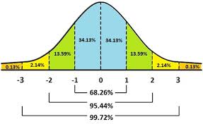
Continuous Distribution
Normal distribution
it was described by Abraham De Moivre
In a ND Mean=median=mode
It is a bell shaped curve
Total area under the curve is 1
50% of the values are less than the mean and50 %of values are above the mean
It is symmetrical about the center
We could use normal curve to predict the chance of happening something.
It gives us the idea the what the data actually look like.
It also describes that 68.26% of all observation are within ±1 standard deviation and95 % are within ± 2std deviation and 99 % are in ±3 Std deviation.

Slide 66
UNIVARIATE ANALYSIS
It deals with simple data set pertaining to a single variable . It includes
Measures of central tendency
Measures of dispersion

Slide 67
Measures of central tendency
A measure of central tendency (also referred to as measures of center or central location) is a summary measure that attempts to describe a whole set of data with a single value that represents the middle or center of its distribution. Following are the different measure of central tendency
Mean
Median
Mode
Geometric mean
Harmonic mean
Quadratic mean

Slide 68
Mean :The mean is the sum of the value of each observation in a dataset divided by the number of observations. This is also known as the arithmetic average.
Median :The median is the middle value in distribution when the values are arranged in ascending or descending order.
Mode :The mode is the most commonly occurring value in a distribution.
Geometric mean – the nth root of the product of the data values, where there are n of these items. This measure is valid only for data that are measured absolutely on a strictly positive scale
Harmonic mean – the reciprocal of the arithmetic mean of the reciprocals of the data values. This measure too is valid only for data that are measured absolutely on a strictly positive scale
The Quadratic mean (often known as the root mean square) is useful in engineering, but is not often used in statistics. This is because it is not a good indicator of the center of the distribution when the distribution includes negative values.

Slide 69
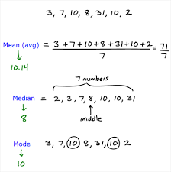

Slide 70
MEASURES OF DISPERSION
Dispersion in statistics is a way of describing how spread out a set of data is. When a data set has a large value, the values in the set are widely scattered; when it is small the items in the set are tightly clustered.
Range: the difference between the smallest and largest number in a set of data.
Standard deviation: It is the probably the most common measure. It tells you how spread out numbers are from the mean,
Interquartile range (IQR): It describes where the bulk of the data lies (the “middle fifty” percent).
Interdecile range: The difference between the first decile (10%) and the last decile (90%).
Variance : It is the expectation of the squared deviation of a random variable from its mean, and it informally measures how far a set of (random) numbers are spread out from their mean

Slide 71


Two sets of data
-10, 0 ,10,20,30
Range = 40
Variance = 200
SD = 10$\sqrt[10]{2}$
8,9,10,11,12
Range = 4
Variance = 2
SD=$√2$

Slide 72
Parametric and Non Parametric measures
Parametric Measures
Conventional statistical procedures are also called as parametric tests.
In a parametric test sample statistic is used to estimate population parameter
The main assumption relying behind parametric testing are the samples are drawn from normally distributed population.

Slide 73
Testing of Hypothesis
The various steps involved in testing are
Select a data sample from the population
Make an assumption that whether the data is normally distributed or not
Set up a null hypothesis that is H_{0:} µ= specified value
Set up an alternative Hypothesis H₁ : µ ≠specified value
µ > specified value
µ< specified value
Choose an alpha or significance level at 5% or 1%
alpha is the probability of having a null hypothesis that is indeed true but our data says that it is wrong
Select the test statistic
Decide the critical value : critical value is the value of test statistics which separates acceptance region from rejection region.
Form a decision rule computation of test statistic value
Conclusion or decision

Slide 74
Here while testing there are two types of hypothesis.
Directional
Non directional
Directional hypothesis are those type in which the data are either positively related or negatively related , i.e.; the one tailed test
Non directional hypothesis are the hypothesis used in two tailed test were we say as there is no significant difference between observed and expected frequencies.
Also to mention two types of errors can also commit while testing the hypothesis i.e.,
Type 1 error
Type 2 error
Type 1 error occurs when rejecting the null hypothesis when it is true
Type 2 error occurs when accepting null hypothesis when it is false.
In order to minimize both the errors we are fixing the confidence level as 95 %

Slide 75
Testing normality
Normality: This assumption is only broken if there are large and obvious departures from normality
This can be checked by
Inspecting a histogram
Skewness and kurtosis ( Kurtosis describes the peak of the curve Skewness describes the symmetry of the curve.)
Kolmogorov-Smirnov (K-S) test (sample size is ≥50 )
Shapiro- Wilk test (if sample size is <50)
(Sig. value >0.05 indicates normality of the distribution)

Slide 76
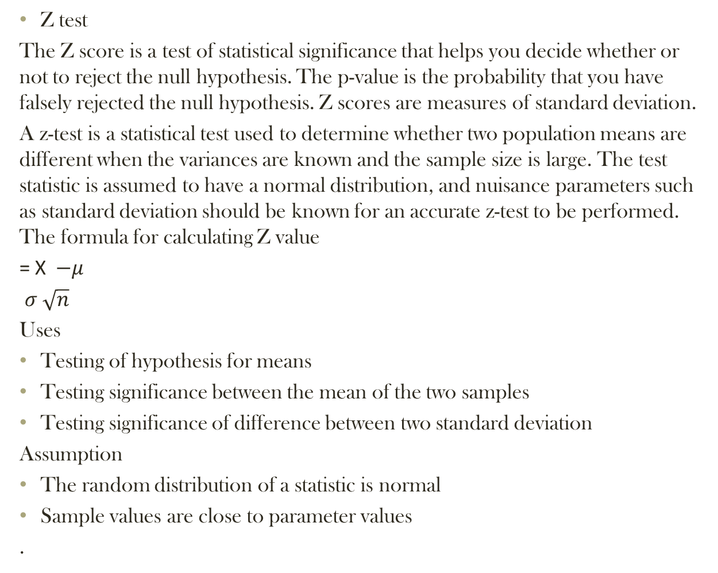
Parametric measures
Z test
The Z score is a test of statistical significance that helps you decide whether or not to reject the null hypothesis. The p-value is the probability that you have falsely rejected the null hypothesis. Z scores are measures of standard deviation.
A z-test is a statistical test used to determine whether two population means are different when the variances are known and the sample size is large. The test statistic is assumed to have a normal distribution, and nuisance parameters such as standard deviation should be known for an accurate z-test to be performed. The formula for calculating Z value
= X$−μ$
$σ \sqrt{n}$
Uses
Testing of hypothesis for means
Testing significance between the mean of the two samples
Testing significance of difference between two standard deviation
Assumption
The random distribution of a statistic is normal
Sample values are close to parameter values
.

Slide 77
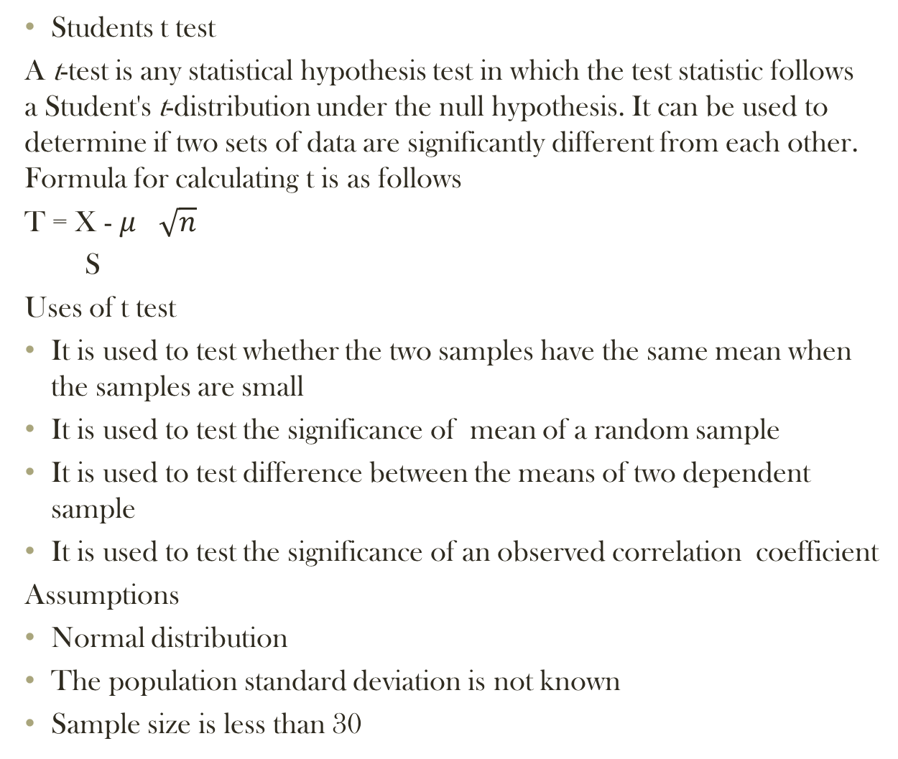
Students t test
A t-test is any statistical hypothesis test in which the test statistic follows a Student's t-distribution under the null hypothesis. It can be used to determine if two sets of data are significantly different from each other. Formula for calculating t is as follows
T = X - $μ$ $\sqrt{n}$
S
Uses of t test
It is used to test whether the two samples have the same mean when the samples are small
It is used to test the significance of mean of a random sample
It is used to test difference between the means of two dependent sample
It is used to test the significance of an observed correlation coefficient
Assumptions
Normal distribution
The population standard deviation is not known
Sample size is less than 30

Slide 78
ANOVA
The term variance was introduced in the statistical analysis by R.A.Fisher
F test is the name introduced to honor R.A.Fisher
F test is used to determine whether the two independent estimates f population variance significantly differ between themselves or to establish whether both variables have come from the same universe
Uses of F distribution
It can be used to test the hypothesis
It can be used to test the equality of variances of two population when samples are drawn
To test the equality of means of three or more population
It is used for testing the significance of an observed sample multiple correlation
It is used to test the linearity of regression
Assumption
Sample follow a normal distribution
All observation are randomly selected
the ratio of greater variance and smaller variance should equal to or greater than one
F distribution is always formed by the ratio of squared values , therefore it can never be a negative number
F = Greater variance
Smaller variance

Slide 79
Non parametric
Non parametric test are used when assumption required by the parametric test are not met
All test involving rank data are non parametric
Non parametric test are distribution free
Assumption of non parametric test
Sample observation are independent
The variables are continuous
Sample drawn is a random sample
Observation are measured o ordinal scale

Slide 80
Non parametric test
One sample
Two sample
K samples
Chi Square
Wilcoxon signed-rank test
Kruskal Wallis test
Sign test
Mann–Whitney U test
Kolmogorov Smirnov test
Median test
Median test
Run test
The Wald–Wolfowitz runs test

Slide 81
Non Parametric tests
Chi square test
The chi square test was first introduced by Karl Pearson.
It is a test which explains the magnitude of difference between observed frequencies and expected frequencies under certain assumptions.
Greater the discrepancy b/w observed & expected frequencies, greater shall be the value of χ2.
Assumptions
The observation are always assumed to be independent of each other.
All the events must be mutually exclusive
A sample with sufficiently large size is assumed
It look like normal distribution but it starts with zero and is skewed with long tail to the right

Slide 82
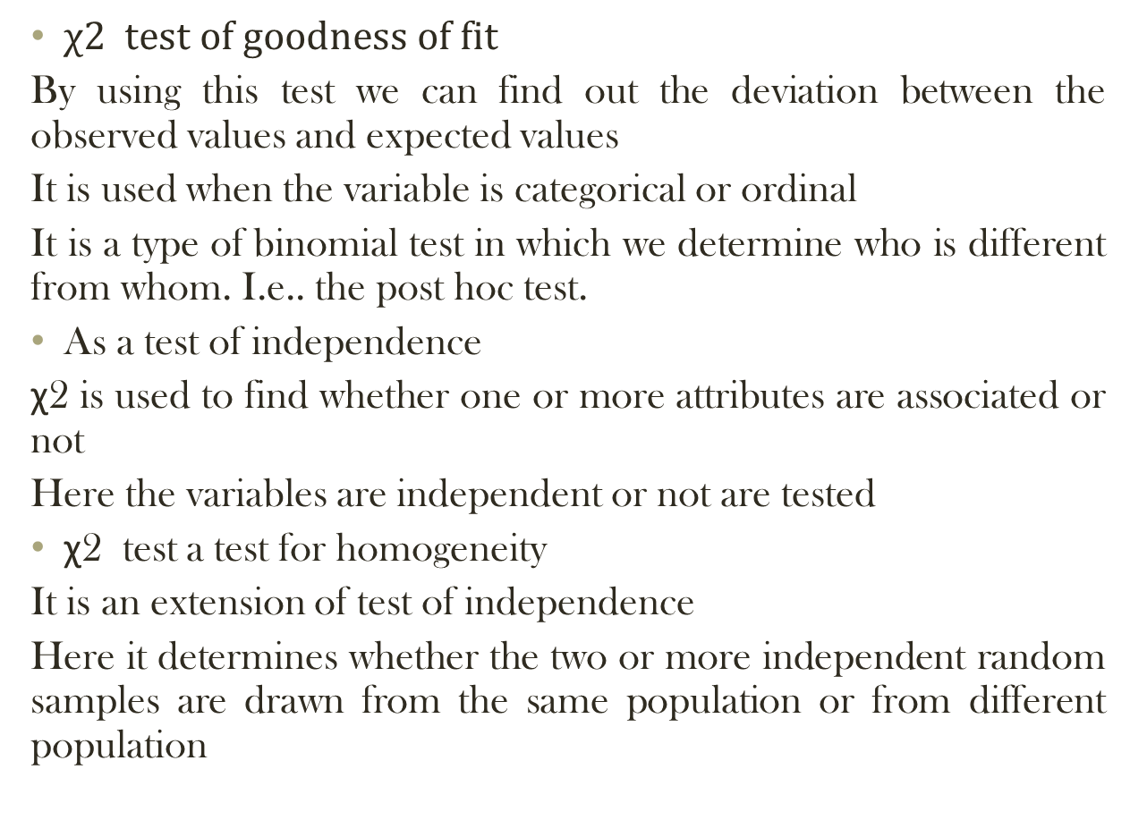
$χ2 test of goodness of fit$
By using this test we can find out the deviation between the observed values and expected values
It is used when the variable is categorical or ordinal
It is a type of binomial test in which we determine who is different from whom. I.e.. the post hoc test.
As a test of independence
χ2 is used to find whether one or more attributes are associated or not
Here the variables are independent or not are tested
χ2 test a test for homogeneity
It is an extension of test of independence
Here it determines whether the two or more independent random samples are drawn from the same population or from different population

Slide 83
SIGN TEST
It is to be applied in case the sample is drawn from a continuous symmetrical population.
Here the mean is expected to be lied at the center and equal number of units are to be lied above and below the mean value.
Simple and easy to interpret
Makes no assumptions about distribution of the data
Not very powerful
To evaluate H₀ we only need to know the signs of the differences
If half the differences are positive and half are negative, then the median = 0 (H₀ is true).
If the signs are more unbalanced, then that is evidence against H₀.

Slide 84
Kolmogorov Smirnov test
For testing the relationship between an empirical distribution and some theoretical distribution or between two empirical distribution goodness of fit test are employed
K-S can be applied to test the relationship between a theoretical and a sample frequency distribution for one sample test or between two sample distributions.
RUN TEST for randomness
The run test has been decided to determined whether the sample is random or not.
The total no. of runs in a sample indicate whether the sample is random or not.

Slide 85
Median test
The median test is used to determine the significance of difference between median of two or more independent groups .
The object is to find out whether the median of different sample drawn randomly are alike or can be taken as drawn from the same population.
It is an application of Chi square test for two variables each having two subgroups.
Mann–Whitney U test
In statistics, the Mann–Whitney U test (also called the Mann–Whitney–Wilcoxon (MWW), Wilcoxon rank-sum test, or Wilcoxon–Mann–Whitney test) is a nonparametric test designed to test the significance of difference between the result of two samples drawn at random from the same population but administered differently .
It can be used as an alternative to t test when parametric assumptions are not met. It is nearly as efficient as the t-test on normal distributions
Here the observation are at least expressed in ordinal scale .

Slide 86
Wilcoxon signed-rank test
The Wilcoxon signed-rank test is a non-parametric statistical hypothesis test used when comparing two related samples, matched samples, or repeated measurements on a single sample to assess whether their population mean ranks differ (i.e. it is a paired difference test). It can be used as an alternative to the paired Student's t-test, t-test for matched pairs, or the t-test for dependent samples when the population cannot be assumed to be normally distributed.
Run test
The Wald–Wolfowitz runs test , named after Abraham Wald and Jacob Wolfowitz, is a non-parametric statistical test that checks a randomness hypothesis for a two-valued data sequence. More precisely, it can be used to test whether the two samples were drawn from the same population.

Slide 87
K sample test
Kruskal – Wallis test
The Mann Whitney U test is used to test the significance of difference between the result of two independent samples where dependent variable is measured on ordinal scale .the K-W extent the use of Mann Whitney U test to three or more independent groups
Median test
It has already been discussed in two sample test . The same can be extended to meet further requirement of K samples

Slide 88
Types of Data
Time Series Data
Cross Sectional Data
Pooled Data
Time Series Data
Time series is a sequence of data points, measured typically at successive time instants spaced at uniform time intervals. Time series data have a natural temporal ordering.
Daily- Weather, Stock Price
Monthly- Unemployment rate
Quarterly- GDP
Yearly- National Budgets
Decennially- Population Census

Slide 89
Cross Sectional Data
Cross-sectional data or cross section is a type of one-dimensional data set. It refers to data collected by observing many subjects such as individuals, firms or countries/regions at the same point of time, or without regard to differences in time.
For example, we want to measure the mobile uses for a particular brand in this campus. We could draw a sample of 100 students randomly from the population, measure their mobile use, and calculate what percentage of that sample is used of that brand. For example, 60% of our samples were used that particular branded mobile. This cross-sectional sample provides us with a snapshot of that population, at that one point in time. Note that we do not know based on one cross-sectional sample if the uses of this brand are increasing or decreasing; we can only describe the current proportion.
Pooled Data
In Pooled or combined data are the element of both time series and
cross-sectional data.

Slide 90
CORRELATIONAL ANALYSIS
Correlation analysis is an attempt to determine the degree of relationship between variables. It is the analysis of co variation between two variables.
The coefficient of correlation ranges between -1 and +1 and quantifies the direction and strength of the linear association between the two variables.
The correlation between two variables can be positive (i.e., higher levels of one variable are associated with higher levels of the other) or negative (i.e., higher levels of one variable are associated with lower levels of the other).
Significance of correlational analysis
It is used as basis for the study of regression
In business it helps the management to estimate costs, sales, price, and other variables.
It helps to reduce the range of uncertainty associated with decision making

Slide 91
Assumption of correlation
Cause and effect relationship exist between the variables .
The relation ship between the variable is linear
The variables follows a normal distribution.
Classification of correlation
Correlation
On the basis of Direction
On the basis of linearity
On the basis of variables
Positive correlation
Linear
Simple correlation
Partial correlation
Negative correlation
Non linear
Multiple correlation

Slide 92
Positive correlation
If the variables are moving and varying in the same direction. It is called positive correlation. I.e.. increase in value of one variable lead to increase in other variable.
E.g.
P : 5 10 15 20 25 30
Q: 15 20 25 30 35 40
Negative correlation
Here the variables are moving in the opposite direction .
E.g.
X : 2 3 4 5 6 7
Y : 6 5 4 3 2 1
Linear correlation and non linear correlation
The distinction between linear and non linear correlation is based upon the consistency of the ratio of changes between the variable understudy.
If the amount of change in one variable follows a constant change of other variable then the correlation is said to be linear

Slide 93
Simple correlation
An analysis were relationship exist between two variables ;one independent ad other dependent is known as simple correlation analysis.
Simple correlation measures strength and type of the relationship between two variables on the assumption that no other variable come into play as such and it is need not to be taken.
It is also called as ‘Zero order correlation’
The statistical measure of simple correlation is known as ‘ Coefficient of Linear correlation’ with symbol ‘r’.
It can be either positive or negative.
Coefficient of simple determination with symbol r² gives the proportion of variation in the dependent variable (y) accounted for the repressor (x).
For e.g. if the value of r² = .81 , this means 81 % of the variation in dependent variable has been explained by repressor.

Slide 94
Partial correlation
It represent the relationship between two variables after the effect of one or more other distracting variable , if any has been eliminated.
Determination of partial correlation is essential to understand the cause effect relationship between variables under observation.
For e.g. ,
In a study it was observed that the correlation between education and income was positive. But it might be entirely due to a third variable say the persons economic status . People with higher economic status earns more money.
Accordingly education and income may have high correlation .

Slide 95
Multiple correlation
Coefficient of multiple correlation determines the nature and extent of proximity in the relationship between one dependent variable and two or more independent variable.
The statistical measure of such a relationship is known as coefficient of multiple correlation, with a symbol R.

Slide 96
METHODS OF STUDYING CORRELATION
a) Scatter diagram
b) Karl Pearson's coefficient of correlation
c) Spearman’s Rank correlation coefficient
d) Method of least squares
Karl Pearson's Coefficient of Correlation
 Pearson’s ‘r’ is the most common correlation coefficient.  Karl Pearson’s Coefficient of Correlation denoted by- ‘r’ The coefficient of correlation ‘r’ measure the degree of linear relationship between two variables say x & y.
Karl Pearson's Coefficient of Correlation 
When deviation taken from actual mean:
r(x, y)= Σxy / √ Σx² Σy² 
When deviation taken from an assumed mean:
r = N Σdxdy - Σdx Σdy
√N Σdx²-( Σdx)² √N Σdy²-( Σdy)²

Slide 97
Spearman’s Rank Coefficient of Correlation 
When statistical series in which the variables under study are not capable of quantitative measurement but can be arranged in serial order, in such situation Pearson's correlation coefficient can not be used in such case Spearman Rank correlation can be used.
 R = 1- (6 ∑ D2 ) / N (N 2 – 1) 
R = Rank correlation coefficient
 D = Difference of rank between paired item in two series. 
N = Total number of observation.

Slide 98
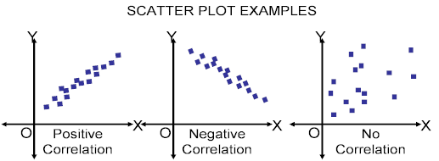
Scatter Diagram Method 
Scatter Diagram is a graph of observed plotted points where each points represents the values of X & Y as a coordinate. It portrays the relationship between these two variables graphically.

Slide 99
REGRESSION ANALYSIS
In statistical modeling, regression analysis is a statistical process for estimating the relationships among variables.
More specifically, regression analysis helps one understand how the typical value of the dependent variable (or 'criterion variable') changes when any one of the independent variables is varied, while the other independent variables are held fixed.
Regression analysis is widely used for prediction and forecasting
Regression line is the line which gives the best estimate of one variable from the value of any other given variable. 
The regression line gives the average relationship between the two variables in mathematical form
Regression can be simple linear regression or multiple linear regression

Slide 100
Simple linear regression
It is a causal relation in which it describe how does a dependent variable changes because of a change independent variable while all other variables are held constant
Simple linear regression is representing a set of clustered data points with best fit line
The line of best fit which represent the data set with the smallest distance between the line and each of the data points.
For a linear regression to work the data set must have two variables that are correlated.
Simple linear regression has 2main objectives
Establish if there is a relationship between variables
Forecast new observation.

Slide 101

Standard form for simple linear regression
y= $β0+ β1 x+ε$
Y = dependent variable
$β0=intercept$
$β1=slope of the line$
$ε$ = error term

Slide 102
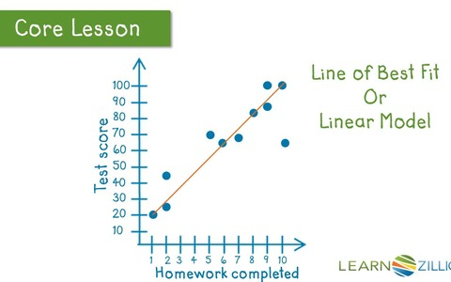
Line of best fit line

Slide 103
Multiple linear regression model
It is about modeling a data a set with two or more independent variable and one dependent variable .
Here the dependent variable is expressed as a function of two or more independent variables in a single equation.
Assumption of multiple linear regression
Only relevant variables are included
A linear relationship is required
Causality of variables
All variables are normally distributed
Homoscedasticity is assumed.
Absence of multicollinearity is assumed in the model.

Slide 104

Standard form for multiple regression model is
Y=$β0+β1x1+β2x2+β3x3….$ +$βnxn$

Slide 105
MULTICOLLINEARITY
Multicollinearity refers to a situation in which two or more explanatory variables in a multiple regression model are highly linearly related. We have perfect multicollinearity if, for example as in the equation above, the correlation between two independent variables is equal to 1 or −1.
a multiple regression model with correlated predictors can indicate how well the entire bundle of predictors predicts the outcome variable, but it may not give valid results about any individual predictor, or about which predictors are redundant with respect to other
Multicollinearity. It's good to have a relationship between dependent and independent variables, but it's bad to have a relationship between independent variables. Effect of single variable hard to measure.

Slide 106
Heteroskedasticity
Heteroskedasticity, in statistics, is when the standard deviations of a variable, monitored over a specific amount of time, are non constant. Heteroskedasticity often arises in two forms: conditional and unconditional
Conditional Heteroskedasticity identifies non constant volatility when future periods of high and low volatility cannot be identified. Unconditional Heteroskedasticity is used when futures periods of high and low volatility can be identified.
Unconditional Heteroskedasticity
Unconditional Heteroskedasticity is predictable, and most often relates to variables that are cyclical by nature. This can include higher retail sales reported during the traditional holiday shopping period, or the increase in air conditioner repair calls during warmer months.
.

Slide 107
In finance, conditional Heteroskedasticity is often seen in the prices of stocks and bonds. The level of volatility of these equities cannot be predicted over any period of time. Unconditional Heteroskedasticity can be used when discussing variables that have identifiable seasonal variability, such as electricity usage.
As it relates to statistics, Heteroskedasticity, also spelled Heteroskedasticity, refers to the error variance, or dependence of scatter, within a minimum of one independent variable within a particular sample. These variations can be used to calculate the margin of error between data sets, such as expected results and actual results, as it provides a measure for the deviation of data points from the mean value.

Slide 108
FACTOR ANALYSIS
Factor analysis identifies correlation between and among variables to bind them into one underlying factor
Factor analysis reduces larger number of variables into smaller amount of factors.
E.g. , in a set of variables (V1,V2,V3,V4,V5,V6)
A correlational relationship may be found between V1,V2,V3
So these variables can be identified as factor because there is higher degree of relationship between these three things.
Accordingly large no. of variables will be reduced to several small no.of factors.
Factor analysis is also referred to as data reduction.

Slide 109
Factor analysis consider either pairs of responses or pairs of variables I.e. Q type and R type factor.
The important terminology used in factor analysis is a factor which is the weighted linear combination of the variables understudy.
The factor loading in factor analysis indicates the extent of closeness of relationship among variables constituting a factor
Another term that is needed to be pointed out in factor analysis is Commonality which indicates the extent of a variable has been accounted for by underlying factor taken together. Higher the value of commonality the variable has been considered by the factor and lower if it left out.
Eigen value : the sum of squares of factor loading relating to factor is called as eigenvalue . It indicates the relative importance of factor in account for the set of variables considered.
Factor rotation: it is done to reveal different structures in data. Different structures give different results but they are statistically equal. There 2 types of rotation Orthogonal and oblique.

Slide 110
Assumption of factor analysis
No outliers in data set
Adequate sample size
The data set must posses no perfect multicollinearity
Homoscedasticity is not required
Linearity of variables
The data must be at least interval data

Slide 111
CLUSTER ANALYSIS
Cluster analysis is a process of identifying natural homogenous group existing in data , so that similarity within group and difference among group may be used for understanding the basic character of the data.
It is applied to large set of data which may consist of many variables.
It is applied to data recorded on interval scale
Here internal homogeneity and external heterogeneity is determined
There are basically two types of clusters
Hierarchical cluster
Non hierarchical cluster

Slide 112
Hierarchical cluster : here first two closest objects are grouped and treated as single cluster . Then the same process is carried out until there is a single cluster containing all the items .
Non hierarchical clusters.: here the items are disbursed into predetermined groups successively in integrative process finally some defined group emerges.
Linkage function of clustering : it is used to find out the distance between two clusters there are two types of linkages
Simple linkage
Complete linkage

Slide 113
CONJOINT ANALYSIS
It is a technique useful in determining relative value of different attributes of an item
In marketing research it helps to find out most desirable combination of a product or service that is existing or proposed to be introduced in the market.
Conjoint analysis is applied to categorical variables
It is done to analyze most important feature of a product.
It gives relative importance to the factor that are taken for consideration.
It helps us to develop alternative sets of combination of different levels of product.
The respondents are given a chance to rate or rank accordingly

Slide 114
It is applied in the following fields
New product development
Transport industry

Slide 115
DISCRIMINANT ANALYSIS
It is a statistical technique useful in classification of individuals or observation into two or more mutually exclusive groups, on the basis of set of predictor variables.
In DA there is one nominal dependent variable and two or more interval scaled independent variables.
IV have certain common characteristic features which are useful in discriminating among individuals
The main object of DA is to classify the observed cases into two or more groups.
DA is applied in following areas
Credit rating
Prediction of sickness
Portfolio selection
Market research
Classification of various attributes

Slide 116
Discriminant function
Linear discriminant function
It is a linear function of predictive variables weighted in such a way that it will discriminate among groups minimizing errors. In case the dependent variable is classified into only two groups this is known as simple discriminant analysis
In case dependent variable is classified into more than two groups it is termed as multiple discriminant function
Bi variate discriminate analysis for two groups
If the no.of variables included in the discriminant function is 2 , there is a straight line classification boundary . An individual on one side belong to group 1 and on the other side belong to group 2

Slide 117
DECOMPOSTION ANALYSIS
It means analysis of as set of data to reveal its composition and thereby express it in terms of extent of change over time in its components.
It reveals the extent of change in structure , the composition and the intensity of a set of data
It is suitable for large mass of data such as financial statements, performance reports , budget etc.
It reveals significant changes in the structure of data over a period of time or from one organization to another.
It pinpoints the area of change
With availability of computers now large data based statements can be subjected to decomposition analysis
DA can be applied in the following areas
Business data analysis
Prediction of financial distress

Slide 118
REPORT WRITING
Research report is a research document that contains basic aspects of the research project
Research report is the systematic, articulate, and orderly presentation of research work in a written form.
It may be in form of hand-written, typed, or computerized.

Slide 119
Report writing stages
Understanding the report brief
Gathering and selecting information
Organizing your material
Analyzing your material
Writing the report
Reviewing and redrafting
Presentation

Slide 120
Content of research report
Research report is divided into three parts as:
I. First Part (Formality Part):
(i) Cover page
(ii) Title page
(iii) Certificate or statement
(iv) Index (brief contents)
(v) Table of contents (detailed index)
(vi) Acknowledgement
(vii) List of tables and figures used
(viii) Preface/forwarding/introduction
(ix) Summary report

Slide 121
II. Main Report (Central Part of Report):
(i) Statement of objectives
(ii) Methodology and research design
(iii) Types of data and its sources
(iv) Sampling decisions
(v) Data collection methods
(vi) Data collection tools
(vii) Fieldwork
(viii) Analysis and interpretation (including tables, charts, figures, etc.)
(ix) Findings
(x) Limitations
(xi) Conclusions and recommendations
(xii) Any other relevant detail

Slide 122
III. Appendix (Additional Details):
(i) Copies of forms used
(ii) Tables not included in findings
(iii) A copy of questionnaire
(iv) Detail of sampling and rate of response
(v) Statement of expenses
(vi) Bibliography – list of books, magazines, journals, and other reports
(vii) Any other relevant information

Slide 123
References
Research methodology - K.R Sharma
Methodology of research in social science –
-Dr O R Krishnaswamy , Dr M Ranganathan
Business research methods – Naval Bajpai
Research methodology , A step by step guide fro beginners – Ranjith Kumar
Introduction to Econometrics –G S Maddala & Kajal Lahiri
Quantitative techniques Dr K venugopalan
www.wikipedia.org

Slide 124
THANK YOU

